Slide 1
Analysis of Most In-Demand Skills for Analysts

Slide 2





Planning
Research Questions
When are company posting most jobs ?
What is the most sought-after skillset ?
How skillset different in different positions ?

Slide 3
Planning
Searching Jobs Types:
Data Analyst
Data Scientist
Quantitative Analyst
Business Analyst
Business Intelligence Analyst

Slide 4

Planning
Key Skillset:
Excel
Java
Python
C
SQL
Hadoop

Slide 5
Planning
Searching Words:
Data
Analysis
Develop
Market
Statistics
Science

Slide 6
Planning
Jobs in Cities:
Boston
San Jose
San Francisco
New York

Slide 7
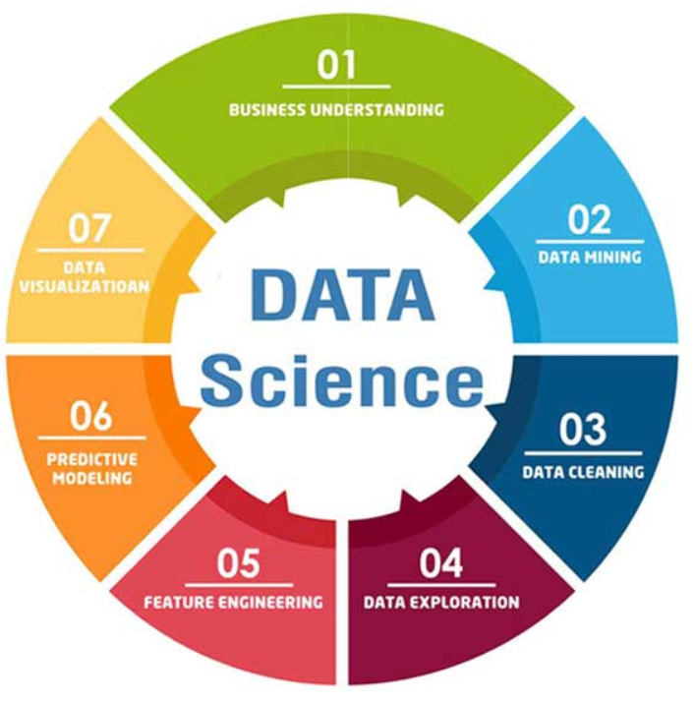
Method / Approach
Data Preparation
Data Cleansing
Data Exploration
Data Visualization
Conclusion

Slide 8
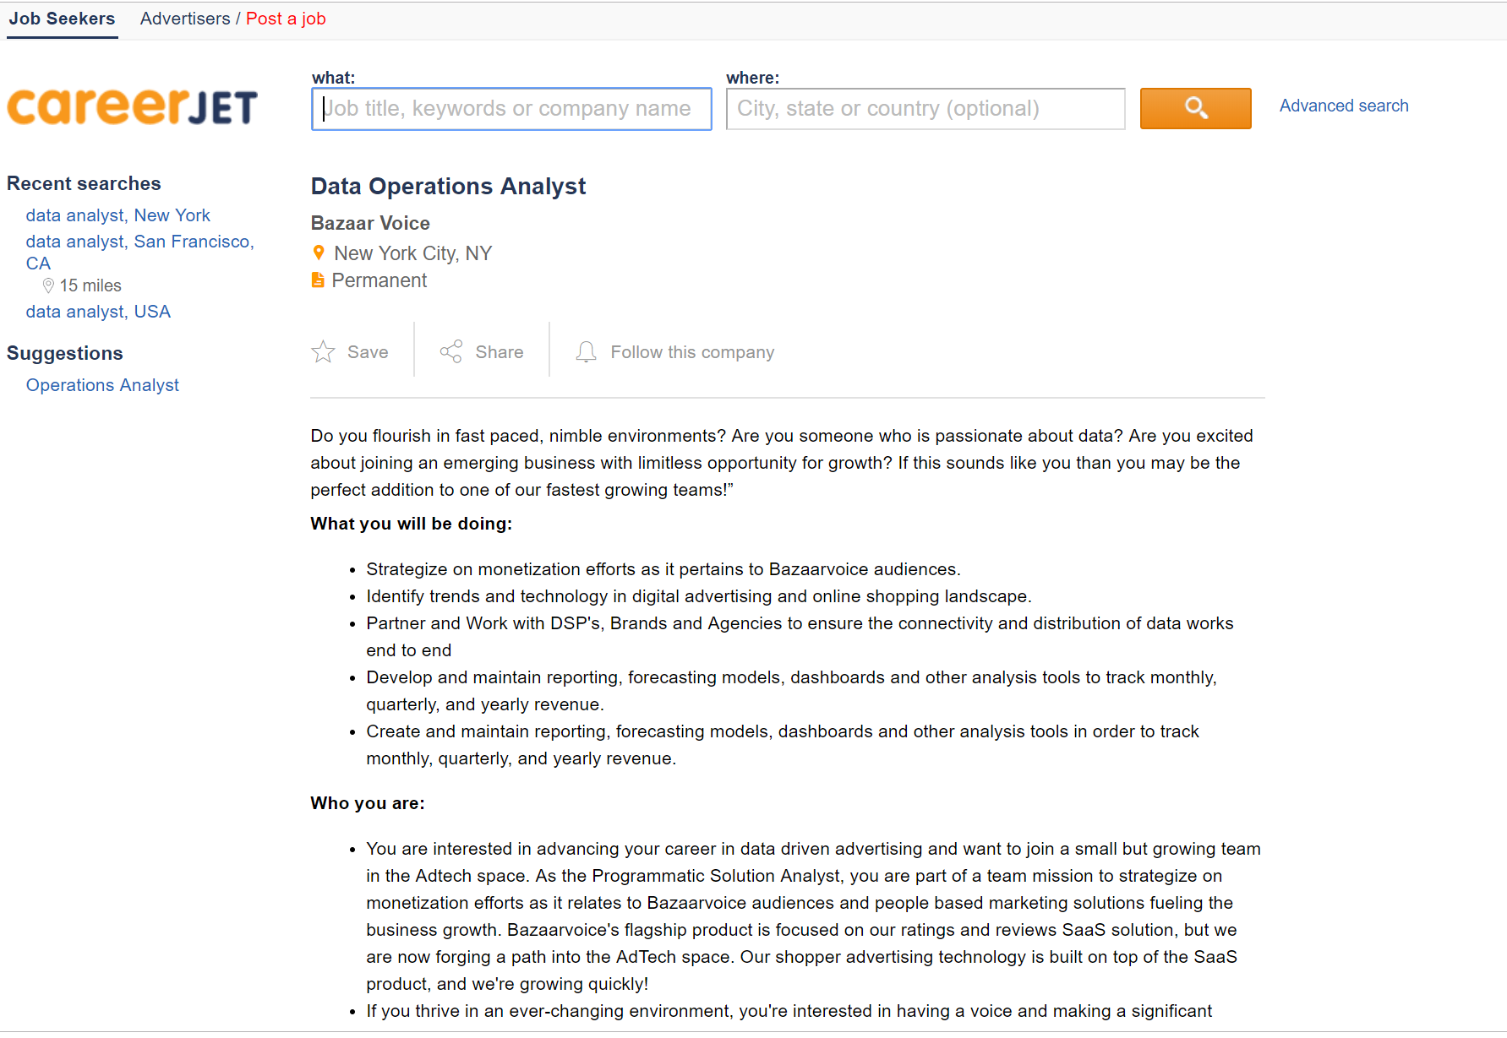

Data Preparation
Get info from CareerJet using API
Collect URL for job postings
Redirect to job page

Slide 9
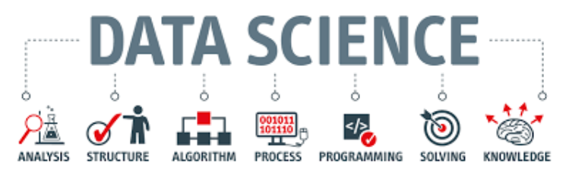
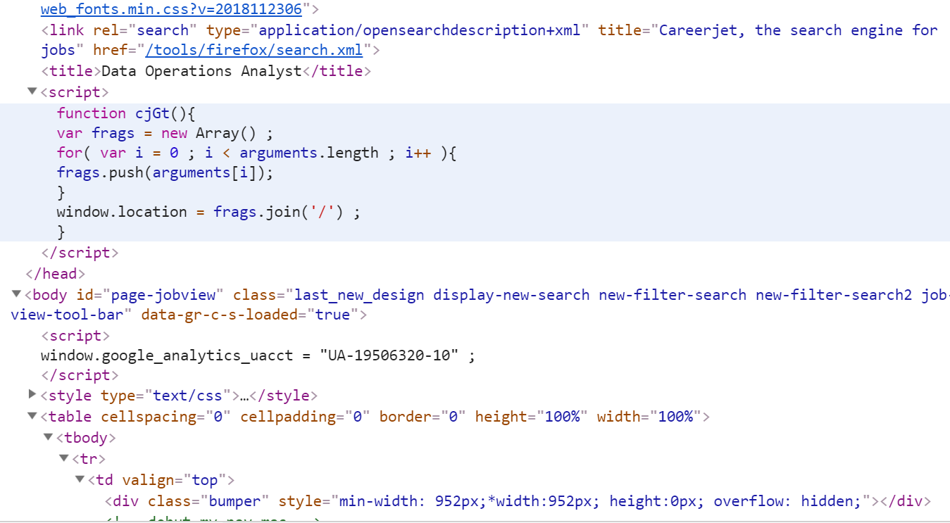
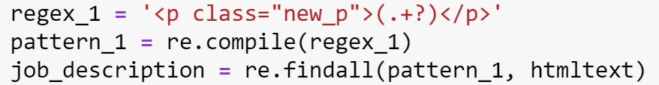
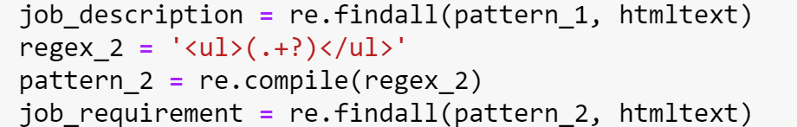
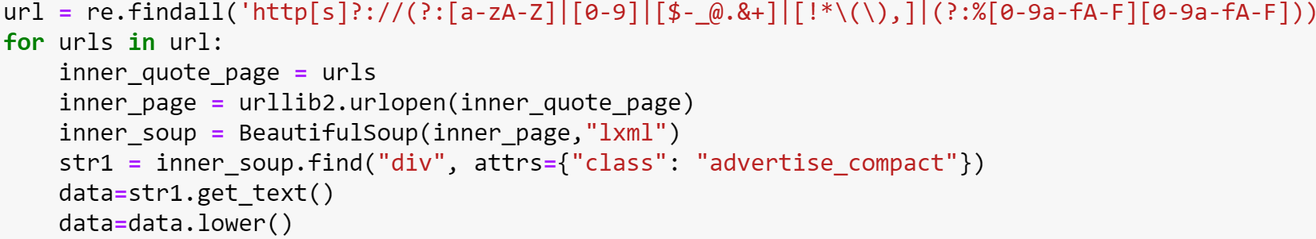
Data Extraction
Get HTML source code/tags
Filter source code

Slide 10
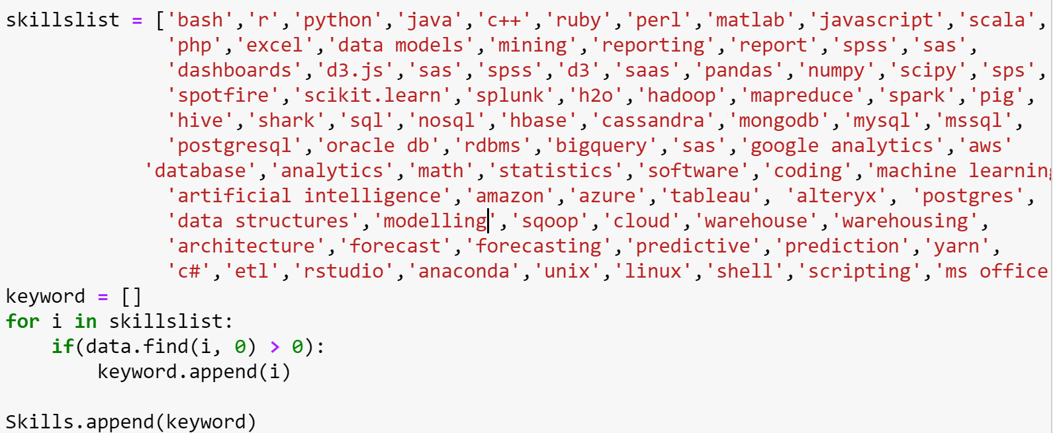
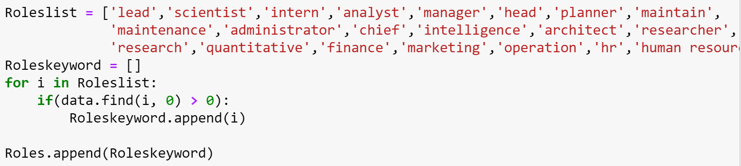
Data Extraction
Find skillslist, Roleslist, Educationlist

Slide 11
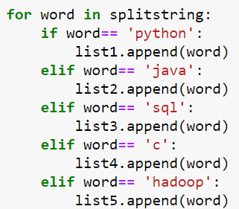
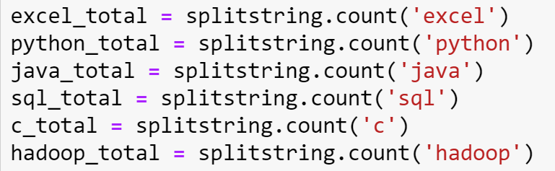
Data Extraction
Count for skills, keywords

Slide 12
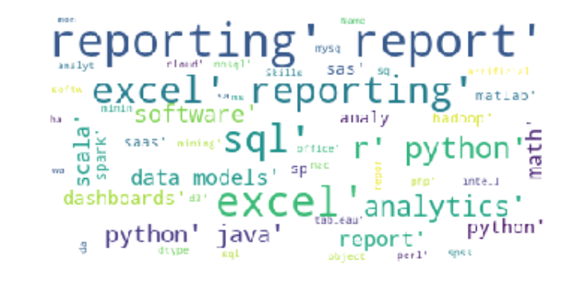
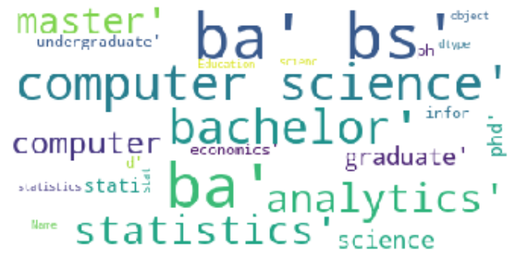
Data Extraction
Word Cloud for skills
Word Cloud for Education

Slide 13
Data Exploration
Count the skills frequency
Count the keywords frequency
Put result in Dataframe / Excel

Slide 14
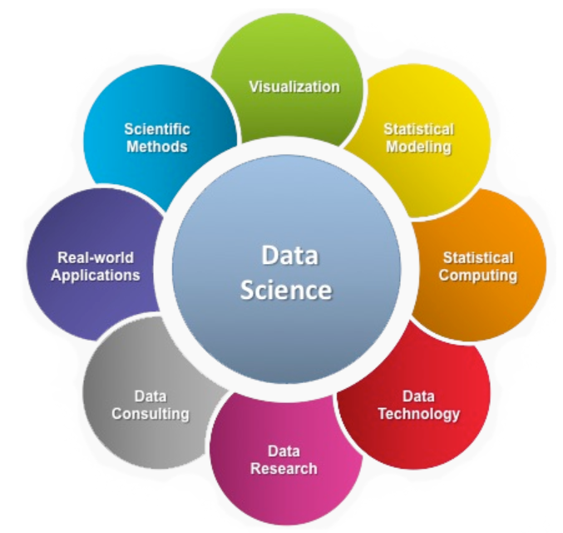
Data Visualization
Graphical presentation
Skillset – One area
Skillset – Multiple areas
Keywords frequency

Slide 15
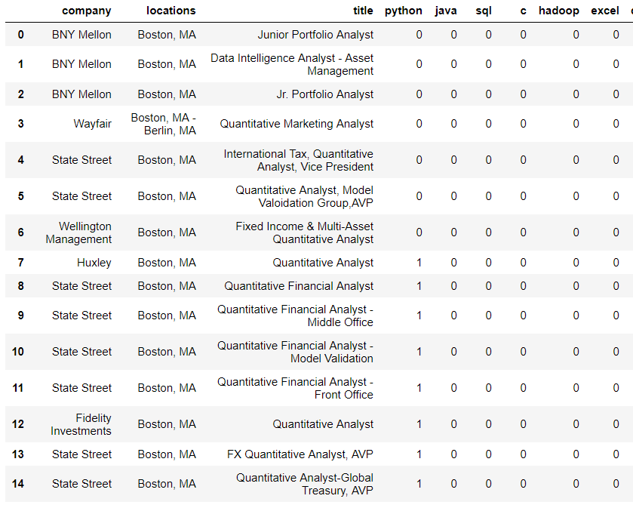
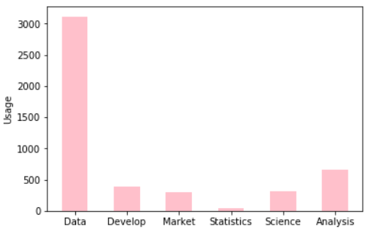
Keywords
Location: Boston

Slide 16
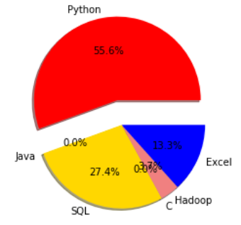
Skills
Location: Boston

Slide 17
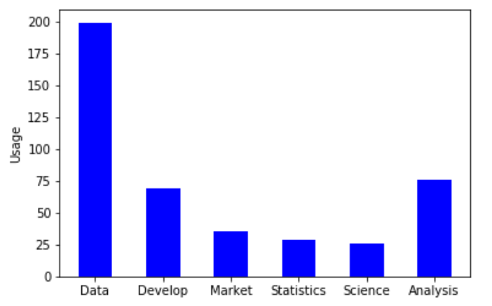
Keywords
Location: New York

Slide 18
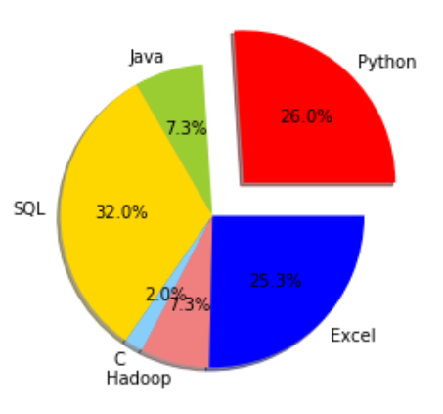
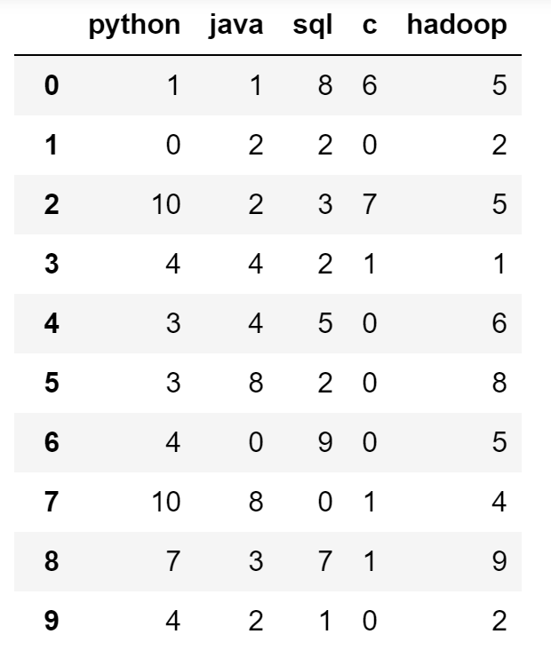
Skills
Location: All 4 cities

Slide 19
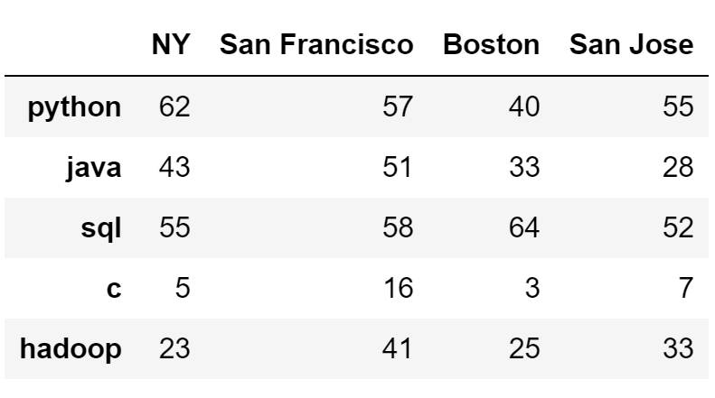
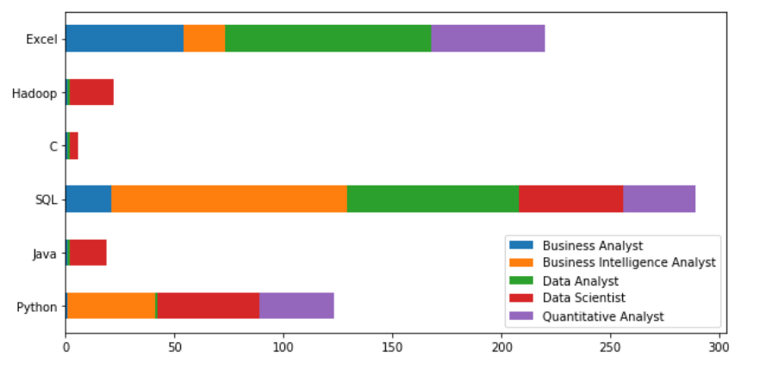
Skills
Area: NY, SF, San Jose, Boston
Jobs: All Combined

Slide 20
Conclusion
In 4 areas (NY, SF, SJ, Boston)
Most Frequent skills: Excel, Python, SQL
Most Frequent keywords: Data, Analysis

Slide 21
Conclusion
Learning:
Prepare data, Clean data, Data visualization
Problems encountered
URL redirect/request time-out
Data Scraping correct info
Complicated data extraction
Count word frequency

Slide 22
Conclusion
How problems solved:
Testing codes
Try different ways
Debug
Team collaboration
Search online

Slide 23
Thank you

